Slide 1

Reducing Administrative Burdens in Billing and Coding with Azure AI FY25 Session 4 Upcoming sessions here
Dhanshri More
Principal Technical Specialist
Notes:
Reducing administrative burdens that add hours onto the workday are the biggest hope that physicians have for how augmented intelligence (AI)—often referred to as artificial intelligence—can change their workplace for the better.
Among physicians who participated in a recent AMA survey, 57% said that addressing administrative burdens through automation remains the biggest area of opportunity for AI to address key needs as workforce shortages continue to increase and as physician burnout continues to be a key concern.

Slide 2


Speakers
Dhanshri More
Principal AI Global Black Belt
Microsoft
Linkdln: Pablo, Marcin

Slide 3



Q&A Moderators
Amit Mukherjee
Principal AI Technical Specialist
Microsoft
Shyam Patel
Principal AI Global Black Belt
Microsoft
Piyush Pande
Principal AI Technical Specialist
Microsoft

Slide 4
Agenda
Topic | Time
Reducing Administrative Burdens in Billing and Coding with Azure AI | 10 minutes
Text Analytics for Health - Deep Dive | 10 minutes
Multi agent system for ICD-10 code extraction | 10 minutes
Code Walkthrough | 15 minutes
Other approach and customization | 5 minutes
Wrap-Up & Q&A | 10 minutes

Slide 5

Benefit for Provider
Reducing Administrative Burdens in Healthcare Billing and Coding with AI
Enhanced Documentation Efficiency
AI-driven tools streamline documentation processes, enhancing efficiency by 2.7× and saving physicians an hour daily.
Improved Billing Accuracy
AI can be used for assigning CPT codes, reducing the $18 billion wasted on denied claims.
Operational Efficiency
Automating tasks increases operational efficiency and preserves cash flow, contributing to a more streamlined healthcare billing process.
Boost in Staff Satisfaction
Reducing administrative burden through AI boosts staff satisfaction by 13-17% in pilot programs, promoting a better working environment.
Source: PubMed Central, Fierce Healthcare, AMA
Notes:
Automating note-taking and code assignment frees providers from routine paperwork and lets them devote more time to patient care.
By catching errors before claims go out, AI can cut denials. This matters because even a single denied claim can be costly
Automating repetitive billing tasks reduces the staff time and expenses tied up in the revenue cycle. By lowering denials and rework, practices preserve cash flow and avoid the extra administrative cycles that drain resources.
Reducing “pajama time” has a measurable morale benefit. In field tests, doctors using AI scribes trimmed end-of-day charting significantly and saw job satisfaction rise

Slide 6

Benefit for Payer
Reducing Administrative Burdens in Healthcare Billing and Coding with AI
Streamlining Claims Processing
AI improves the efficiency of claims processing, saving insurance payers over $11 billion annually and reducing processing times by 30%.
Enhanced Fraud Detection
MAS with reasoning models can enhance fraud detection capabilities, identifying anomalies in real time to prevent fraudulent activities.
Early Intervention for At-risk Populations
Predictive models powered by AI aid in early intervention for at-risk populations, improving health outcomes and reducing costs.
AI-enabled Prior-authorization Tools
AI-enabled prior-authorization tools save 4 minutes per case, reducing treatment delays and enhancing the overall experience for patients.
Source: CAQHindex report, Capco
Notes:
AI can revolutionize insurance by streamlining claims processing, saving payers over $11 billion annually and reducing processing times by 30%. Machine-learning models enhance fraud detection, identifying anomalies in real time. Predictive models aid in early intervention for at-risk populations, while AI-enabled prior-authorization tools save 4 minutes per case, reducing treatment delays and improving overall experience.

Slide 7

Text Analytics for Health
Powerful natural language processing - A Microsoft Cognitive Service that allows to analyze unstructured clinical data in multiple languages
Analyzes clinical data - Extracts medical terms, relationships, assertions & clinical coding linking and structures into FHIR
Integrates with other services - works seamlessly with all Azure platform services and supports FHIR interoperability.
Enables a wide range of scenarios - including patient insights, clinical trials matching, predictive analytics, clinical coding, registries, medical publications knowledge mining, and decision support.

Slide 8
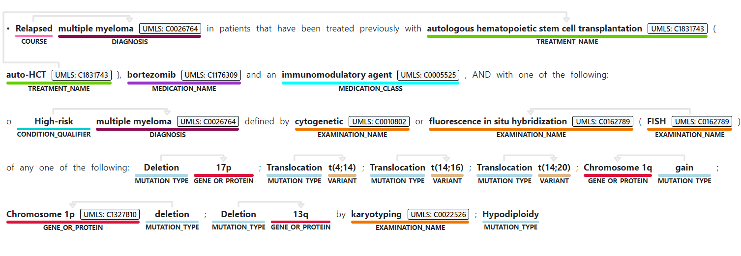
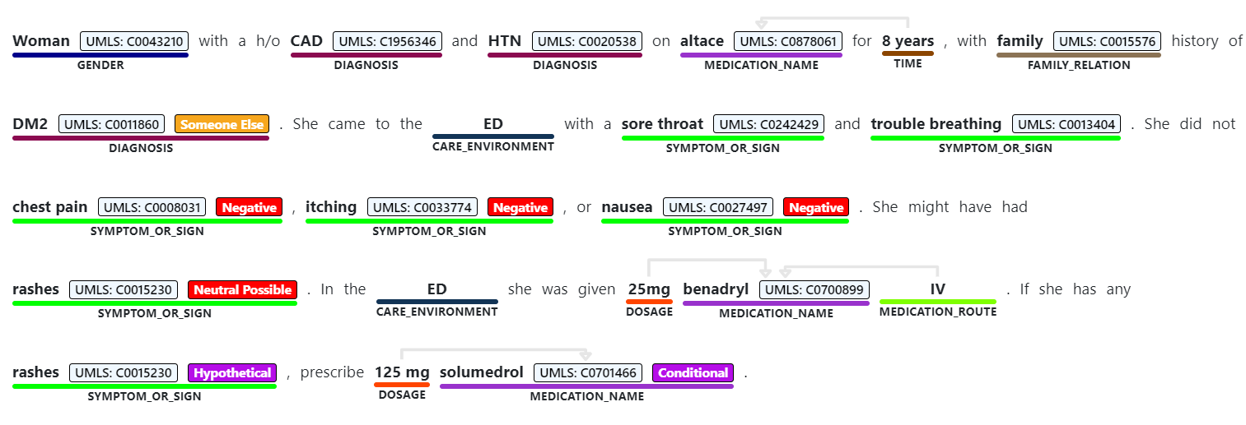
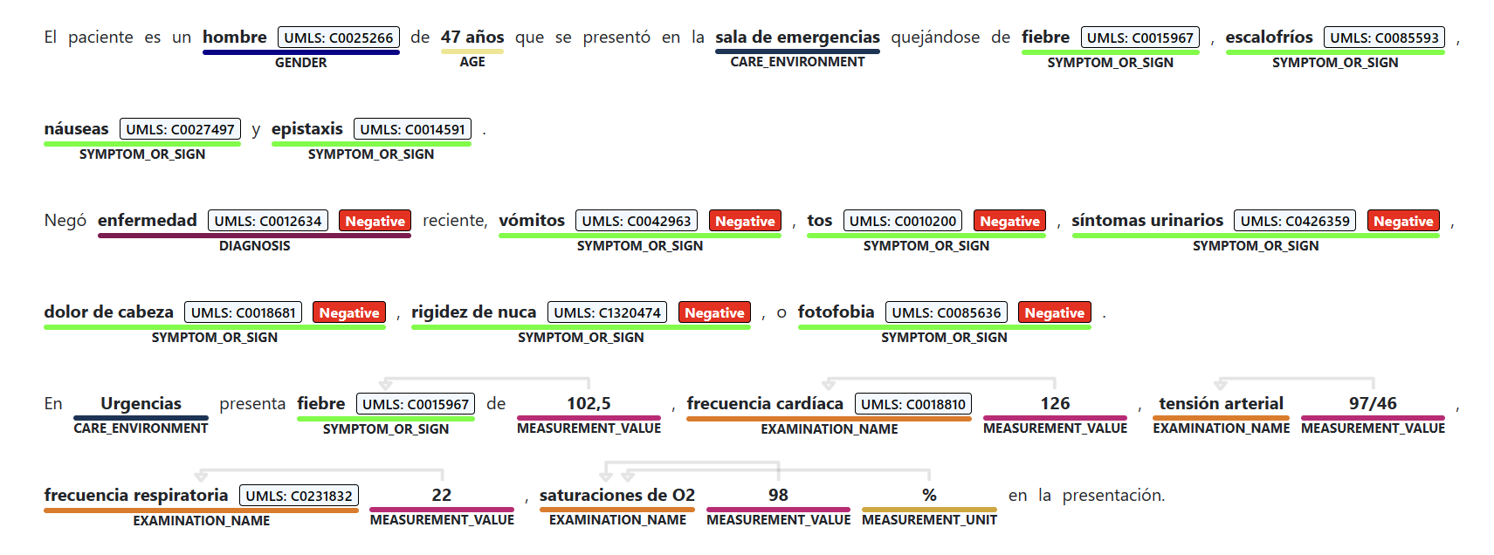

Azure Text analytics for health
NLP service for analysis of clinical and biomedical text, enables extracting insights and driving value from unstructured clinical data
Named-entity recognition: Identify medical terms and classify to domain-specific entities (~35)
Entity linking: Associate entities with concepts from standard clinical coding systems
Relation extraction: Extract semantic relations and dependencies between entities (~40)
Assertions: Detect negation and likelihood, conditionality, association with someone else
Now in 7 languages: EN, DE, FR, PT, SP, IT, HE
Multi-language in GA

Slide 9








How does Text Analytics for Health works
Driving Value from Unstructured Health Data
Improve clinical documentation
Population Insights
Drug Pre-Authorization
Registry Automation
Clinical Trials Matching
Predictive Analytics
Knowledge Mining
Patient Insights
© 2022 Microsoft Corporation All rights reserved

Slide 10
Demo

Slide 11






Multi Agent Architecture Agentic Medical Coding: ICD-10 extraction
ICD10 Coder
Agent
Azure OpenAI
GPT-4.1
Medical Entity
Extractor Agent
NIH API for
ICD-10-CM
Hugging Face
Azure OpenAI
04-mini
MIMIC IV Dataset
Orchestrator
Validator
Agent
Azure OpenAI
GPT-4.1

Slide 12
Let’s break down the options
Model Guidance

Slide 13
When to use which model type?
Foundation (GPT-*) models
Customer service automation
Compliance automation
Creative and practical applications
Writing help, design, coding workflow
Reasoning (o* series) models
Logical problem-solving
Complex math or coding
Scientific inquiries
Extended conversations

Slide 14
GPT and o* Models
Recent Releases
 | Use Cases | Key Features | Advantages
GPT-4.1 | Customer Service Chatbots Data Analysis Tools Machine Learning Applications | Enhanced Coding Longer context input Improved instruction following | Consistently produces outputs that compile and run successfully Generates cleaner, simpler front-end code Understands extensive context in a single interaction
o3 | Complex problem-solving Multimodal reasoning Enterprise agentic workflows | Advanced STEM capabilities Enhanced coding and logical reasoning Multimodal inputs support Reasoning summaries | Superior reasoning for complex tasks Comprehensive multimodal analysis Robust automation support
o4-mini | Lightweight reasoning tasks Quick analytical insights Streamlined workflow automation | Optimized for smaller workloads Efficient reasoning with lower latency Simplified vision analysis | Cost-effective reasoning Fast and efficient responses Streamlined tool calling

Slide 15
Generally Available
Generally Available
Generally Available
GPT-4.1
GPT-4.1-mini
GPT-4.1-nano
Enhanced coding
Consistently produces outputs that compile and run successfully
Longer context input
1m tokens
Improved instruction following
Especially those containing multiple requests
Reduced latency
Nearly half the latency of GPT-4o
Cost efficiency
Reduces computational cost by 83%
Performance:
Matches or exceeds GPT-4o intelligence
Ultra-low latency
Fastest responses in the 4.1 series
High efficiency
Lowest computational cost
Performance
Scores 80.1% on MMLU, 50.3% on GPQA, and 9.8% on Aider polyglot coding.
1m token context Length
Improved coding for agentic workflows
Improved instruction following
June 2024 knowledge cutoff

Slide 16
Generally Available
Generally Available
o3
o4-mini
Advanced STEM capabilities
Enhanced coding and logical reasoning
Reasoning summaries
Parallel tool calling
Multimodal inputs support:
Vision analysis
Comprehensive text outputs
Optimized for smaller, lighter workloads
Efficient reasoning with lower latency
Concise reasoning summaries
Streamlined tool calling
Multimodal inputs support:
Simplified vision analysis
Targeted text outputs
Agentic workflows
Support for 200k context window
Enhanced coding and logical reasoning
Multimodal reasoning

Slide 17
Demo

